Slide 1
Angular
Day 1
Session 1

Slide 2
Objectives
What is SPA (Single Page Application)?
What and Why Angular?
Angular CLI and creating an Angular application
Angular Architecture
Angular Core Concepts (high level overview)
NgModules
Components
Directives and Pipes
Services

Slide 3
What is SPA (Single Page Application)?
In order to understand SPA, first we will have to understand client-server arch. With request and response.
Request(https://timesofindia.indiatimes.com/india)
Response by Server
Request for specific article
Response by server
So, here we can see two requests and two responses from server. So, for both request page will be loaded.
We can also observe this behavior of web pages from dev. Tools. New HTML pages along with some resources will be reloaded.
Server
Client

Slide 4
What is SPA (Single Page Application)?
Now, we will visit an existing SPA. (https://angular.io/)
Here we can observe that whole application will be loaded at once only but for further requests only data will be fetched and arranged in html format without reloading pages.

Slide 5
What is SPA (Single Page Application)?
Definition:- A single page application(SPA), also known as single page interface which is nothing but a web application or web site that fits on single web page with goal of providing more fluid user experience like desktop application.

Slide 6
Dynamic Websites vs Static Pages vs Single Page Apps
You know how the web works - the browser sends a request, the server returns a response. If a webpage was requested, the response contains HTML code which then is used by the browser to render the website.
But how does the HTML code, which is returned, end up on the server?
Is it generated "on the fly" (per request)?
Is it "pre-generated" (i.e. are the finished HTML pages uploaded onto the server)?
It turns out, that there are three main alternatives when it comes to rendering websites (and the HTML code that is required):

Slide 7
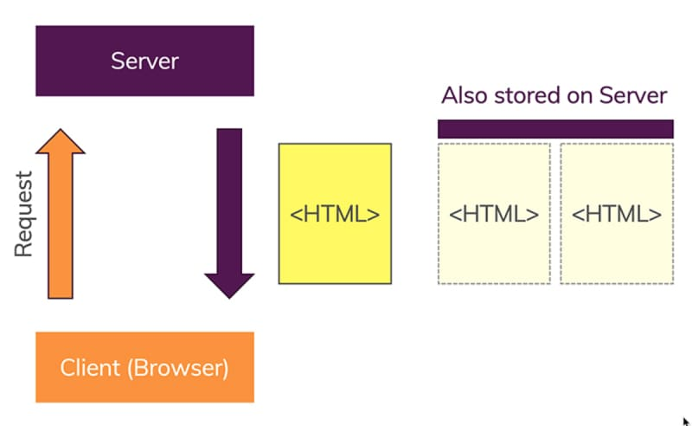
Dynamic Websites vs Static Pages vs Single Page Apps
It turns out, that there are three main alternatives when it comes to rendering websites (and the HTML code that is required):
1. Static Pages
HTML pages were pre-generated and are stored as such on the server - typically, those pages are not hand-written but also generated automatically (but before they're uploaded) with the help of a static site generator

Slide 8
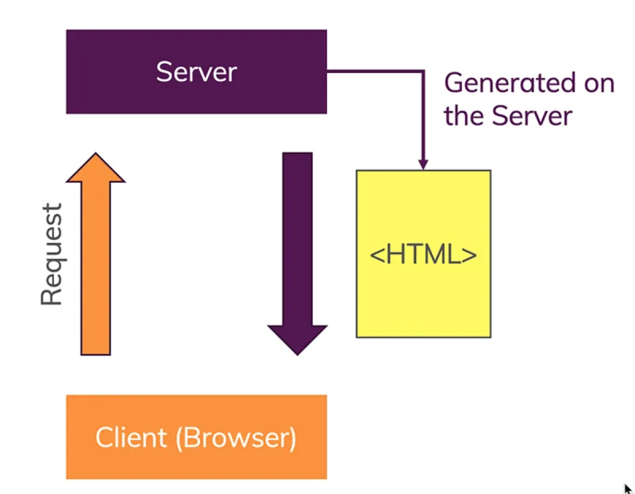
Dynamic Websites vs Static Pages vs Single Page Apps
2. Dynamic Pages
HTML pages are created dynamically, on the server - with the help of a server-side programming language and typically also a "templating engine"

Slide 9
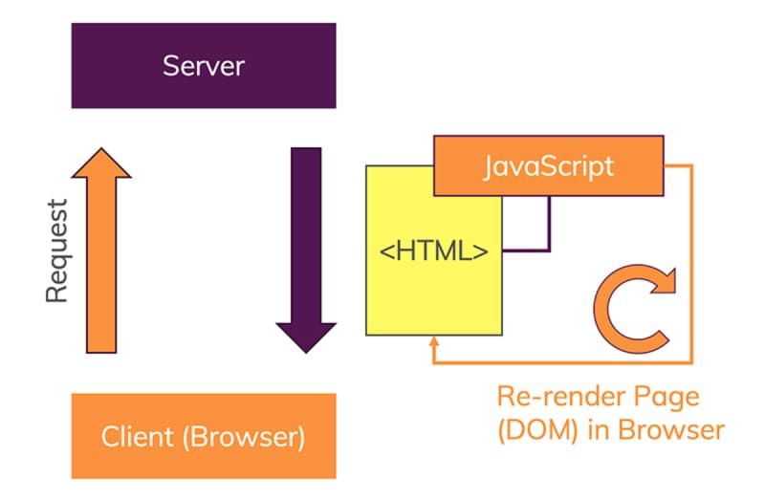
Dynamic Websites vs Static Pages vs Single Page Apps
3. Single Page Applications
The server returns one single, pre-generated HTML page which in turn contains JavaScript code that changes the page dynamically in the browser (this approach is known as a "Single Page Application" or "SPA")

Slide 10
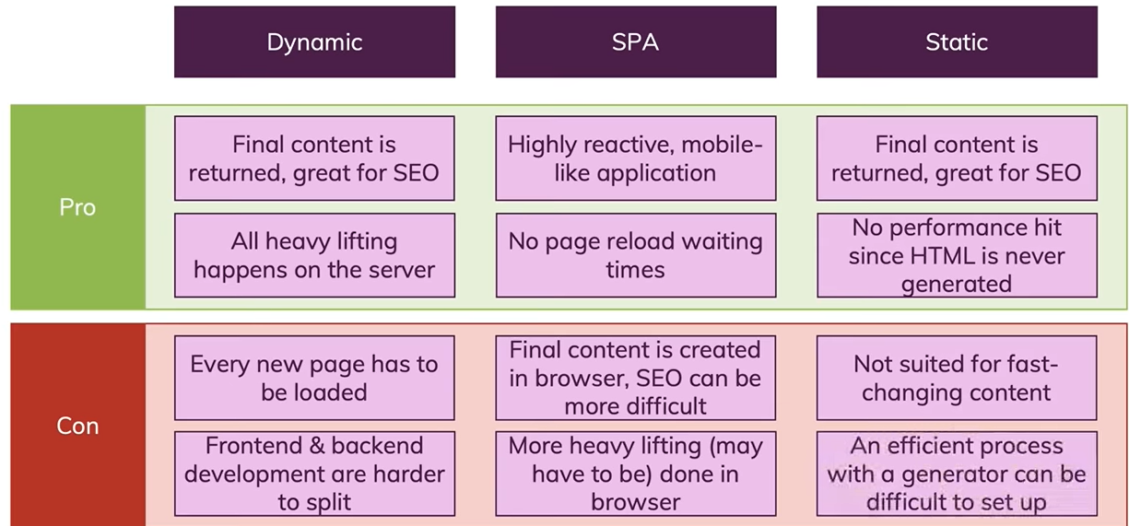
Dynamic Websites vs Static Pages vs Single Page Apps
Pros and Cons.

Slide 11
Why Single page application?
So, here we can answer that why SPA? SPA is fast, as most resources (HTML+CSS+Scripts) are only loaded once throughout the lifespan of application. Only data is transmitted back and forth. The development is simplified.

Slide 12
What and Why Angular?
Angular is a development platform, built on TypeScript. As a platform, Angular includes:
A component-based framework for building scalable web applications
A collection of well-integrated libraries that cover a wide variety of features, including routing, forms management, client-server communication, and more
Let’s visit official web site for details:
https://angular.io/guide/what-is-angular

Slide 13
Why Angular is so popular in modern application development?
Angular is a highly popular web development framework that offers rich user experiences, fast responsiveness, and code maintainability.
Angular provides two-way data binding and ability to build cross-platform progressive web applications quickly and easily
It is a versatile framework that enables to build dynamic and interactive Single-Page applications

Slide 14
Angular Versioning..
Angular Version List & History
Following are the Angular version release dates:
Angular version 1.0, which is known as AngularJS, was released in 2010 by Google
Angular version 2.0 was released in September 2016
Angular 4.0 was released in March 2017
Angular 5.0 was released in Nov 2017
Angular 6.0 was released in May 2018
Angular 7.0 was released in Oct 2018
Angular 8.0 was released in May 2019
Angular 9.0 was released in Feb 2020
Angular 10.0 was released in June 2020
Angular 11.0 was released in Nov 2020
Angular 12 is released in May 2021
Angular 13 is released in Nov 2021
Angular 14 is released in June 2022

Slide 15
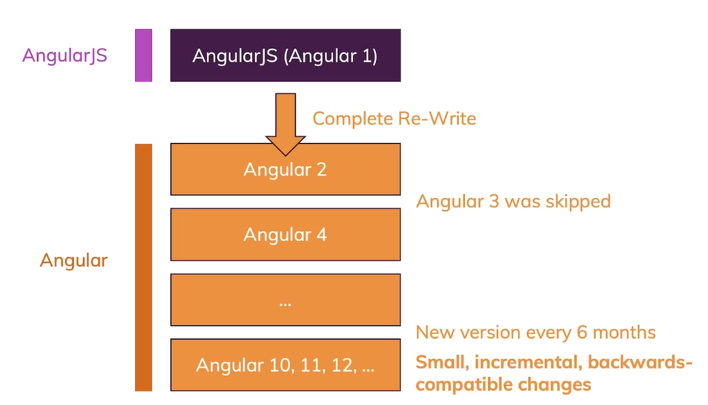
Angular Versioning..
Angular 1 or Angular js was the first version introduced by google, but eventually google realized it’s not futuristic therefore they rewritten Angular again and released it as Angular 2.

